Slide 1
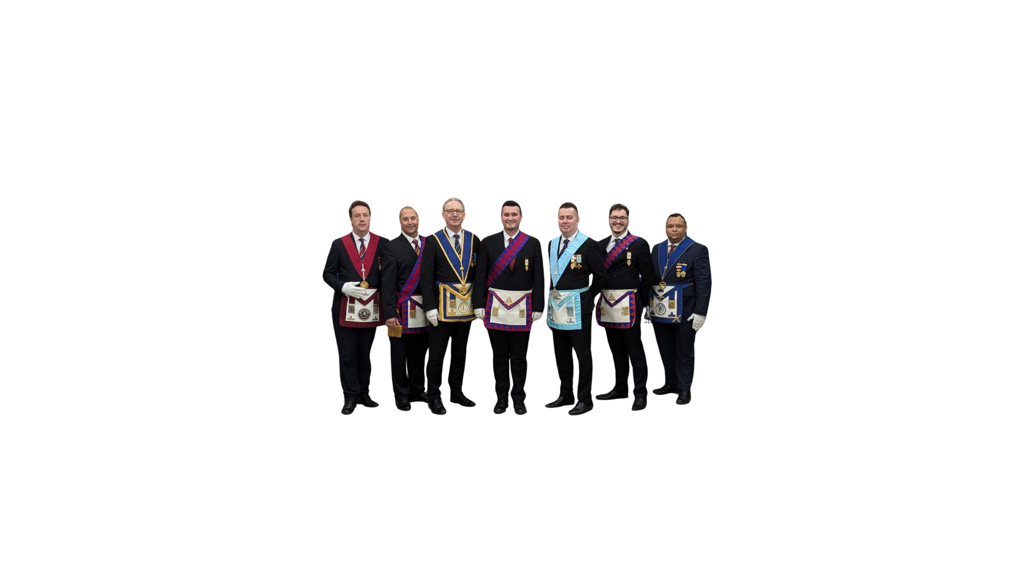

Afternoon Workshop:
Session 2: Continue
SPOCs, Membership Officers, Communication Officers
How Master Masons become the right Companions in the right Chapter
Notes:
Ed R

Slide 2
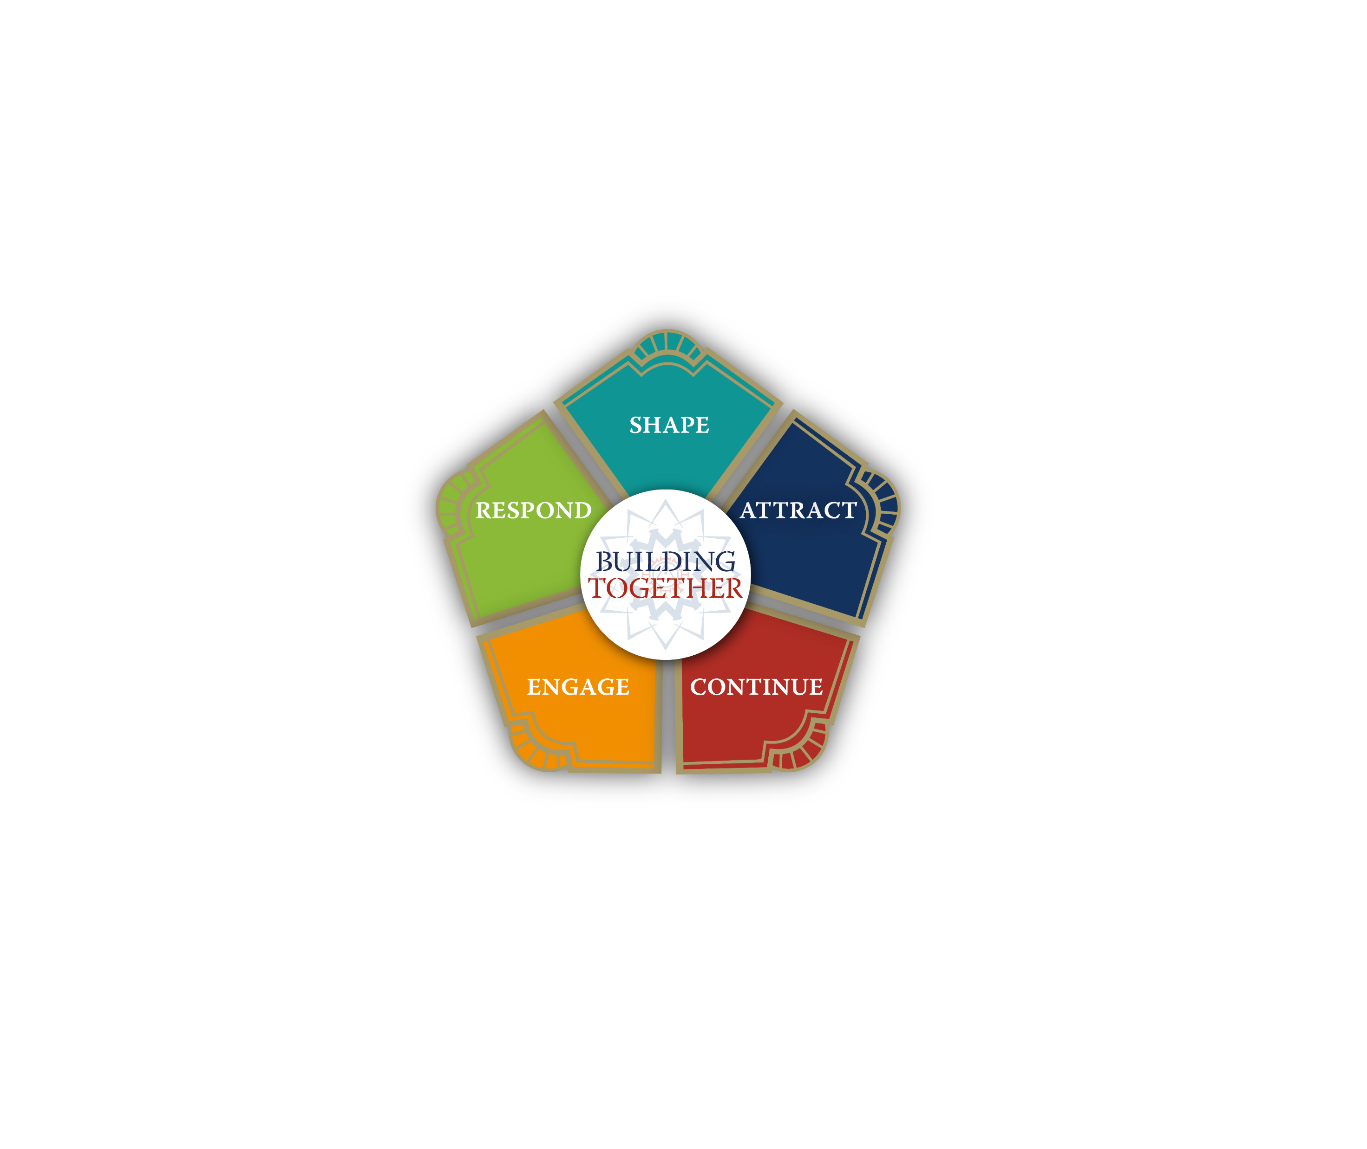
Notes:
OK question 1 - Why do we need a Continue hub at all
There are lots of similarities between Shaping a Chapter and Lodge, Engaging Brethren and Companions and Responding to situations that may arise in the units – Lodges and Chapters
However, Attract and Continue are different. Continue is aimed at encouraging existing Master Masons, of some experience, to continue their journey into the Royal Arch
There is an argument that Continue could have been positioned on the pentagon after Engage and the argument is valid. Afterall the Master Mason will surely only move on to the Royal Arch if they are engaged in and enjoying their experience as Freemasons
On balance though the design team wanted to emphasise that Engage deals with both Lodges and Chapters as units within Freemasonry and whilst there are some differences, running a Lodge is very similar to running a Chapter. Therefore, Continue is positioned before Engage.
BTW the differences are fully covered in Engage

Slide 3
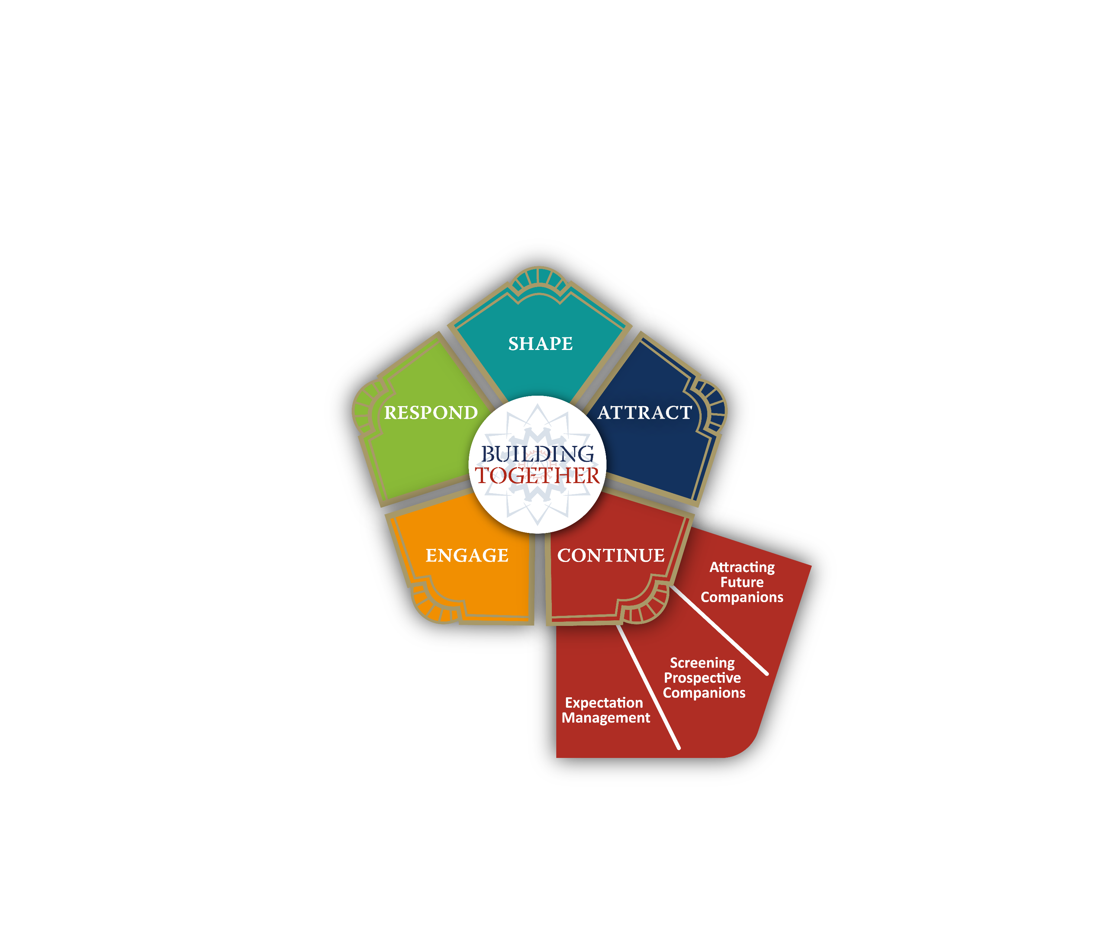
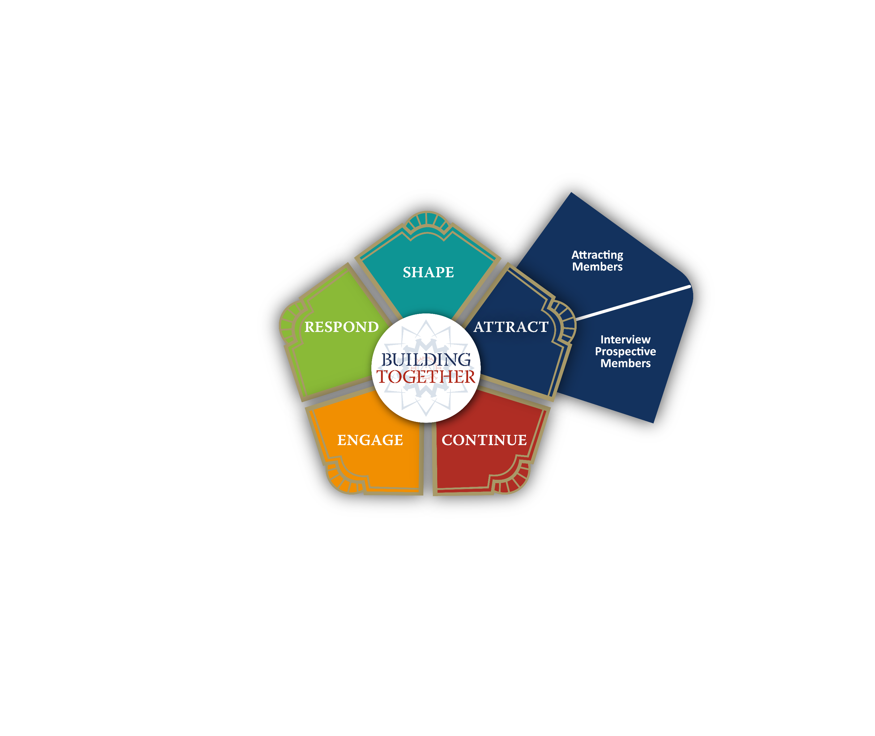



Notes:
Of course the major difference between Attract and Continue is the different target audience that face Lodges and Chapters.
Each unit has it’s own challenges
A Lodge is trying to attract people who are not Masons and may know little about Freemasonry at the start of their journey
A Chapter on the other hand is trying to attract free and accepted masons and encourage them to continue their journey through masonry and into the Royal Arch
The Royal Arch being the first and natural step as the Master Mason moves forward. The graphic shows the layman entering Freemasonry through Attract and then moving on through Continue

Slide 4
Notes:
The Continue Hub then has three main Elements
Attracting future Companions
Screening prospective Companions
Expectation management

Slide 5
Notes:
The ability to attract future Companions is greatly enhanced by having a consistent, positive and upbeat narrative (a story to tell) about the Royal Arch in general and the individual Chapter in particular.
And in the research that we undertook during the development of Archway we found that this consistency was pretty scarce
The Hub highlights some good practice for creating a description of your Chapter, derived from the work in Shape

Slide 6

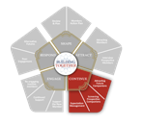





CONTINUE
Attracting Future Companions
Promoting your Chapter
The Continue Hub, focuses on how a Royal Arch Chapter can ensure they have the correct resources to promote their Chapter and how each
Companion can be empowered to speak with knowledge and confidence of what it means for them to me a member of The Royal Arch.
When promoting your Chapter you are speaking to an audience of Master Masons. In contrast to when someone is at the start of their journey you will be speaking to Brethren who can understand and appreciate some aspects of masonic culture and practice.
Developing a Chapter Information Sheet which can be used by prospective candidates is key to ensuring future members are able to make an informed decision on what day of the week, time, location, cost and frequency of when their Chapter may meet.
Matching a Master Mason to a Royal Arch Chapter which is not a good fit for their pre-existing commitments, could in the long term, prove detrimental to their membership of the Royal Arch.
In addition to developing your Information sheet, the talking heads presentation and discover more booklet are resources which you will find useful.

Slide 7



By reading the thread and support material you will be better placed to understand the steps Companions and the Chapter Membership Team will need to take to support Master Masons in their Journey
to be Companions and maintaining their engagement;
Thread Link:
Promoting your Chapter
CLICK PDF icon to download the support material
Chapter Description
Using Discover More
Using Talking Heads
TALKING HEADS – A
presentation for use in Lodges

Slide 8
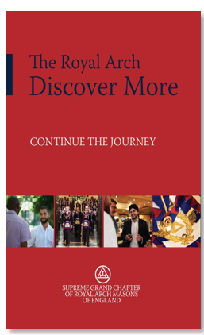
Notes:
It also advocates the use of the Discover more booklet to give Companions the consistent “sales arguments” about the benefits of becoming a Royal Arch Mason.
Both are vitally important and consistent messages are a key factor for success in recruiting
Again research has shown us that the final and deciding criteria for a Master Mason to join the Royal Arch is a personal invitation from a trusted friend. Which means all Companions indeed all Brethren are RA champions. It just makes sense for us to have consistent messages about the RA and indeed our own Chapter which everybody can use in their own way as they talk to prospective candidates . The hub gives us this guidance about what to say and just as importantly what not to say about the RA and our Chapter. The fourth degree, the HOLY RA and so on
If all RA Companions are champions where does the RA Rep’s role come in – good question
Under One journey, one organisation people are no longer joining the Craft, they are joining Freemasonry which includes the RA. This has always been the case really, remember the preliminary declaration, but this point seems to have got lost over the years. So there is now a new emphasis for existing Craft officers, Mentors, Membership Officers etc. to go even further in promoting the RA. The RA rep can act as a subject matter expert, a coordinator and facilitator of existing effort. The rep is an additional resource for the Lodge team to coordinate and amplify the work that is already being done. This has often been referred to as a whole Lodge approach
The theme also discusses latest thinking on feeder Lodges and promotional events for the RA. such as Talking Heads
The Building Together toolkit as a whole is intended to be organic in its development and there will be more examples of tried and tested promotional activity available in future

Slide 9

CONTINUE
Why Join & Discover More are two functional support materials, and no matter how experienced a Companion you are, utilising the resources in the Engage Hub, which relate to further learning and mentoring about the Royal Arch (including the Welcome Companion Booklet), will ensure the basis of your knowledge is enhanced.
Attracting Future Companions
All Companions are RA Champions
All Companions have the opportunity to be Royal Arch ambassadors. Ensuring that we highlight the fun and enjoyment which is derived from membership of the Royal Arch is a key way to encourage Master Masons to look to continue their journey.
Knowing what not to say is also essential. Phrases and descriptions that may have once been told to you or you may have overheard could be wrong, but it has become customary to use them. The support material, What not to say, provides companions with a useful resource to ensure they can act as informed Companions.
Companions have already developed a series of valuable materials, listed in this Thread as support materials, which can be vital in helping members explain what the Royal Arch is. Taking the skills you have developed in your Lodge, build your statement as to ‘what benefits/ pleasure you get from being a member of your lodge, now look at how you can use similar language to explain to Brethren about
Royal Arch Chapters.
On this occasion, the text in the extended thread matches what is written here, BUT these SUPPORT MATERIALS are essential reading:
Thread Link:
All Companions are RA Champions
CLICK PDF icon to download the support material
Using Discover More
Why Join
What not to say

Slide 10

CONTINUE
Attracting Future Companions
Royal Arch Reps
Not all Provinces have Royal Arch Representatives, some use different titles such as Royal Arch Liaison Officers and many other variations. For the purpose of Building Together we have used the term Royal Arch Rep as this is most commonly understood.
A non-collared office in a Lodge, the Royal Arch Rep is the Lodge’s Champion of the Royal Arch, this does not exclude any other Companion advocating the Royal Arch as all Companions
should be Royal Arch Champions.
The Royal Arch Rep should work in conjunction with the Lodge Mentor and personal mentors of EAs, FCs and MMs to help give context to the Royal Arch and support the Lodge mentoring team in signposting suitable Royal Arch Chapters which meet in locations, dates and times that would meet the needs of the Brother.
No Brother should be influenced to join a Chapter which does not meet their needs simply because this is a Chapter associated with the Lodge, it is important the meeting schedule meets the Brother / Future Companions needs otherwise we create the first step on the journey to future dissatisfaction.
A full review of ways in which a Royal Arch Representative can contribute and resources available can be found in the full thread together with a suite of support materials.
Royal Arch Reps
Thread Link:
CLICK PDF icon to download the support material
Using Talking Heads

Slide 11
CONTINUE
Attracting Future Companions
Where Prospective Companions Come From
Prospective Companions can only come from Lodges and invariably Lodges that are successful in generating new members through well managed attraction events and a programme of good mentoring and support will be those who provide engaged Master Masons keen to continue their journey.
Feeder Lodges can fit the description to the left, however in some Provinces some Royal Arch Chapters have sought to take the good practice from Archway (or adapt the Members’ Pathway ideas) and look to engage with all of the brethren of all of the Lodges that meet at their Centre / City ensuring Brethren have an awareness of that Chapter for when they look to continue their journey.
Traditionally many Companions join their Royal Arch Chapter owing to a link it may have with the Lodge of which they are a member. It was not so much an evaluated choice for the Brother as to which Chapter they join, but a well-established path trodden by other members. This type of journey is perhaps most common where the Lodge and Chapter share the same name.
Provincial Royal Arch Promotion Events—Many Provinces are using the One Journey, One Organisation approach to stage Provincial (sometimes broken down to area depending on the province’s size) events to engage with Brethren eligible to join the Royal Arch and unattached Companions.

Slide 12

These events rarely promote a specific Chapter but look to inspire Master Masons to continue their journey. Then, based on their desired days of the week to meet, locations, frequency, and budget, a suitable chapter can be identified, and an introduction made.
The text above duplicates the full thread and should you wish to read as a PDF you can do so here:
Thread Link:
Where Prospective Companions Come From

Slide 13
Notes:
Screening prospective Candidates is an area that is completely different in the RA to the Craft. In the Craft the focus is on making sure we are recruiting the right individual. In the RA we know we have the right individual. It is more about finding the right Chapter for them to join and that they understand the additional commitment they are taking on as well as the benefits they will get.
Traditionally Chapters have relied on so called feeder Lodges closely associated with them. This of course may not be the right Chapter for some prospects. It might not be the right night, brethren may want to broaden their masonic circle. There are many factors that a prospective member should be encouraged to consider before choosing a particular Chapter to join
If we don’t help get these factors right at the beginning, it will be pretty difficult to engage with them fully later on. We run the risk of losing them before we start.
This theme deals with both these challenges choosing the right Chapter and making sure the prospective candidate understands the additional commitment they will be making.

Slide 14

CONTINUE
Screening Prospective Companions
The Right Chapter
Continuing your journey as a Freemason and joining a Chapter is seen by many as a logical progression on your journey of learning and discovery.
Unfortunately, errors by well-meaning Royal Arch Representatives confusing encouragement with pressuring may have blinkered some individuals’ perception of the Royal Arch.
This can be further compounded by the reality that owing to absence of mentoring as a new Companion they fail to understand the significance of symbolism they have experienced within the ceremony.
These are not traits unique to the Royal Arch, some Lodges have experienced issues with the production line of initiates who leave quickly owing to lack of support; on rare occasions some members respond well to
the sink or swim approach and develop their own route to access support and guidance but this is rare!
Successful Lodges provide Brethren with an engaging programme of events supported by mentoring, which means that those looking to join a Royal Arch Chapter invariably will expect similar engagement and support once they become Companions.
Just as Lodges are encouraged to screen prospective candidates, Royal Arch Chapters are encouraged to ensure that:
Is the Prospective Companion right for their Chapter?
Is the Chapter right for the Prospective Companion?
If either is in doubt, other Chapters should be considered.
The Right Chapter
Thread Link:

Slide 15
CONTINUE
Screening Prospective Companions
Commitment
There are a number of differences between Craft and Chapter membership, all of which have associated financial commitments, from the frequency of meetings to the increased up-front costs associated with joining.
Time should be spent with Prospective Companions as part of the screening process, ensuring that, not only are they not overcommitting financially,but that they have:-
Time for an additional commitment
Bandwidth in terms of commitment to learning new ritual, this can be an opportunity to informally introduce the various offices in the Royal Arch and discuss their desire to progress once a member. This interest should be balanced against their Work, Family and Craft commitments to ensure the Prospective Companion isn’t overcommitting.
This discussion on commitment should be friendly and informal, using examples relating to the Brothers’ experiences in their Lodge so they can easily understand and appreciate.
As highlighted in other material, using the Chapters’ Information Sheet and Discover More can be helpful resources for this discussion.
This text duplicates the full thread a PDF copy you can find here:
Commitment

Slide 16
Notes:
.Expectation management
Building on the last theme, particularly Commitment. We should try to make sure candidate’s expectations are clear before they join. Obviously, we don’t want to give too much away about the ceremony and RA story itself but we can explain the similarities and differences and of course we can re emphasise the benefits of membership explained in the Discover more booklet

Slide 17

CONTINUE
Expectation Management
Meetings / Festive Boards
A Prospective Companion looking to join the Royal Arch only has their experience gained in their Lodge. It is likely they only have one Craft Membership at the time they are looking to Continue their journey of discovery and as such they have little to base their expectations on.
The Chapter’s Information Sheet is a key resource when explaining to Prospective Companions;-
Meeting Frequencies – both actual meetings and rehearsals (invariably Royal Arch Chapters meet on much reduced frequency compared to Lodges)
Costs, both in subscriptions and purchase of regalia
Difference in Vocabulary and Officers, it may prove beneficial to explain who some of the KEY ROYAL ARCH OFFICERS are and compare them to roles that they will understand from
the Lodge ie: ScribeE is the Secretary etc.
The Number of Ceremonies
The Discover More Booklet and Why Join support material can be a helpful basis for discussion.
This text duplicates the full thread a PDF copy you can find here:
Meetings and Festive Boards

Slide 18
CONTINUE
Ensuring the candidate understands that this will be what they wear until they go into the “equivalent of the WM’s Chair” as such they will get good few years wear.
Signposting options for where they can buy the regalia, ensuring they buy the right items. (This signposting may also include the option of Pre-Loved Regalia if the Province runs such a scheme, and the member would be interested in that option.
They should also remind the Prospective Companion that when they come to the meeting where they join, in addition to bringing their new Royal Arch Regalia, they should bring a Master Mason’s Apron.
This text duplicates the full thread a PDF copy you can find here:
Regalia
Expectation Management
Regalia
For a Prospective Companion joining the Royal Arch is hopefully an experience that they are looking forward to, some candidates however can be surprised at the associated upfront costs:
The upfront costs of purchasing regalia may be a surprise – especially with how different the regalia and jewel is to what is worn in Lodge.
The candidate’s sponsor, Chapter Membership Officer, Lodge Royal Arch Rep and / or the Brothers Lodge / Personal Mentor can all play a role in setting expectations about regalia

Slide 19
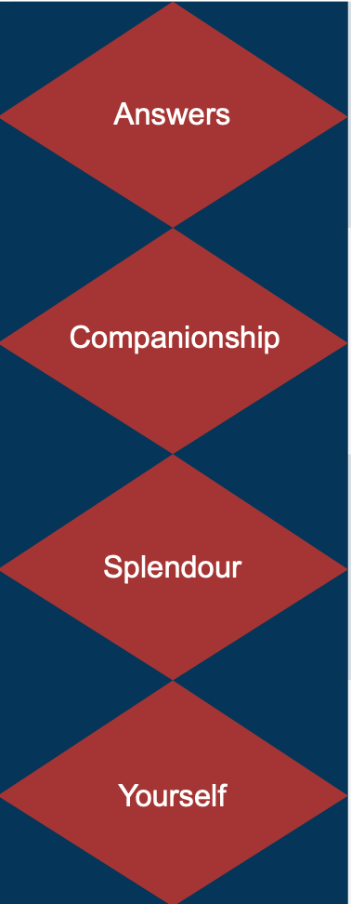
Notes:
Answers, Companionship, Splendour, Yourself
This theme explains the meetings and festive board and points out the need for new regalia which can be an additional expense.
Fees can vary from Chapter to Chapter but are normally much less than Craft fees
Frequency and timings also vary widely
It also explains a little about the new vocabulary and the different Officers Scribe and Secretary for example
And finally there is a word about the Festive Board

Slide 20
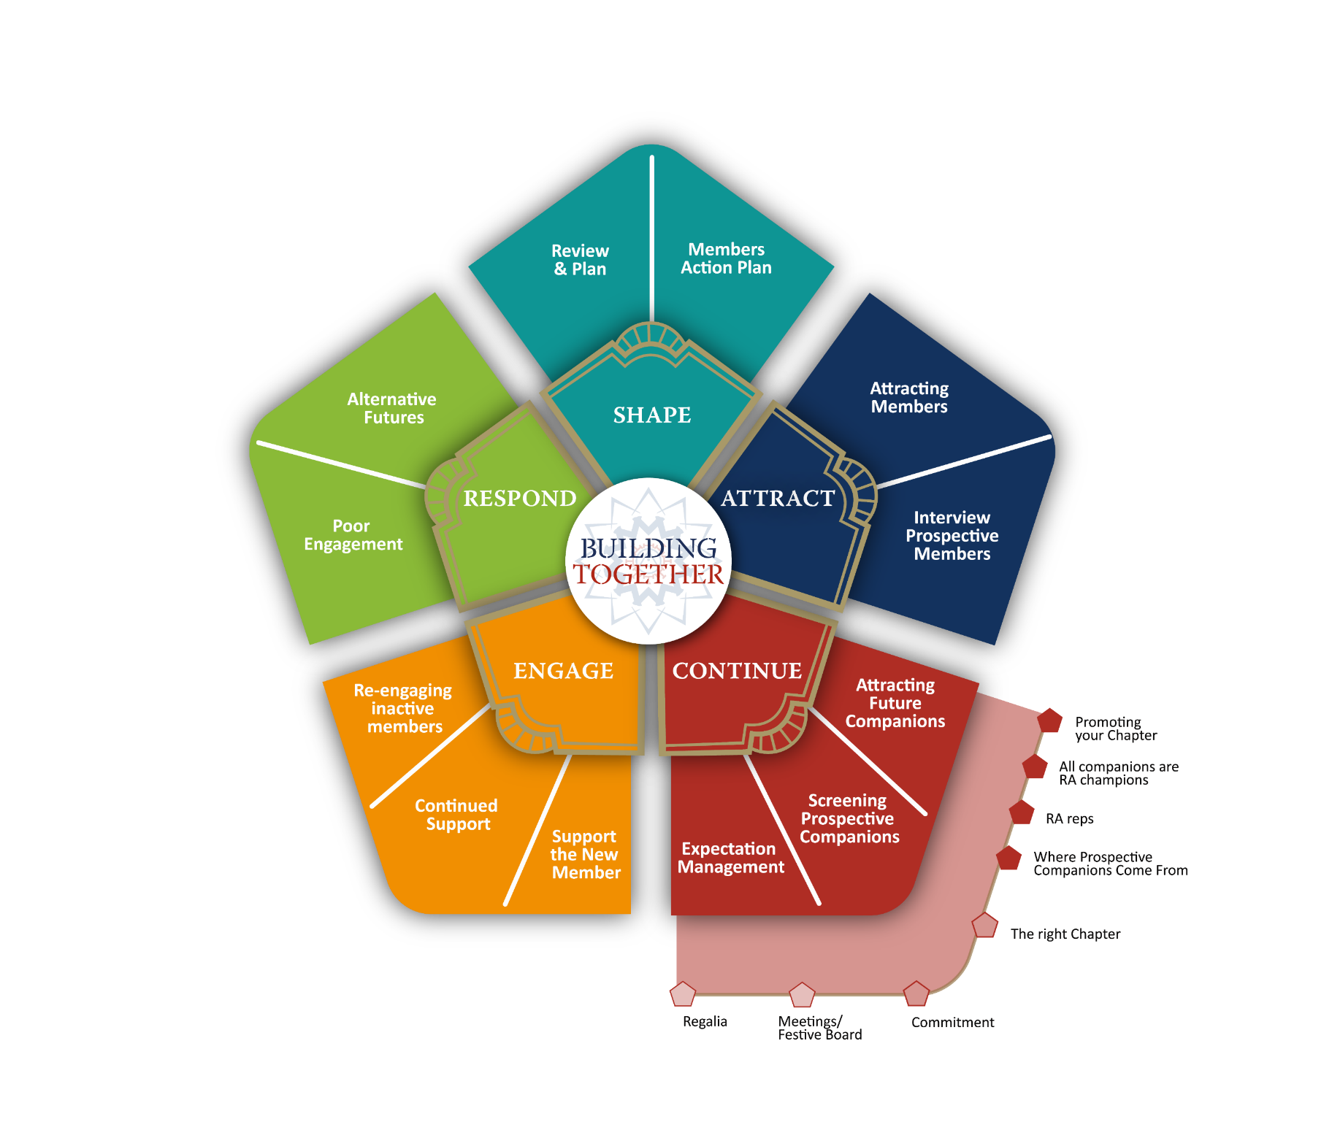
Notes:
Putting all this together the themes and threads will guide, encourage and support Brethren and Companions to find the best way to recruit new Companions.
It also gives the prospective candidates the information they need to make their final decision and choose the right time to join and the right Chapter for them

Slide 21
Thread resources within the Continue Hub
Chapter description
Using Discover more
Using Talking heads
Why join the Royal Arch
What not to say
Guidance for Royal Arch reps
Where do prospective candidates come from
The right Chapter
Commitment
Meetings and Festive Boards
Regalia
These resources will grow and be updated organically from direct feedback as Building Together is introduced into Provinces
Notes:
To summarise - The Continue hub has three themes
Attract future Companions
Screening prospective candidates
Expectation management
There are also a number threads
Within the threads there are more information sheets to help Brethren and Companions promote the Royal Arch and recruit prospective members
It also give prospects the information they need to make informed and therefore secure choices in deciding when the time is right for them and which Chapter to join

Slide 22


Please return to the main room for our final session

